Slide 1
Intro to functions
Cindy stenger

Slide 2
functions:
One of the coolest structures
in the computer science world is the function.
Functions (sometimes called procedures)
are mini programs that you can use
over and over inside of your bigger program.
This lesson will help you intuitively
understand why combining chunks of code
into functions can be such a helpful practice.

Slide 3

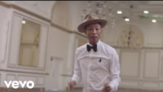
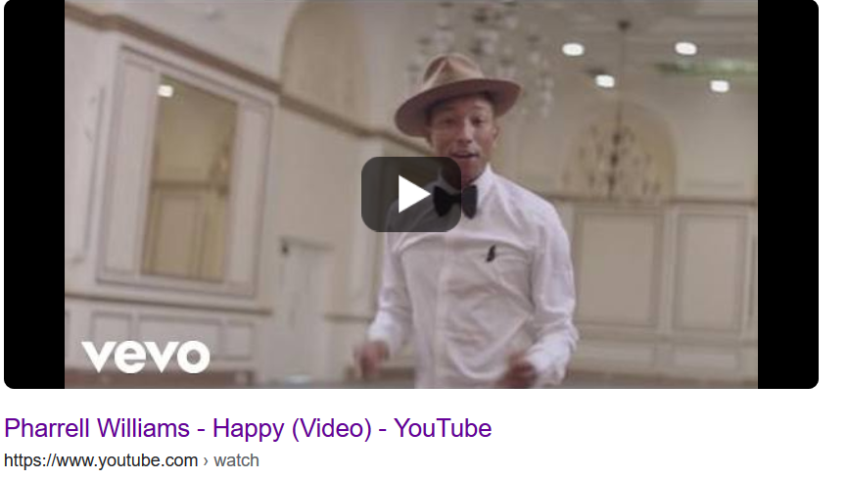

Let’s start with a song:
I thought we were talking about functions

Slide 4
It might seem crazy what I'm about to say Sunshine she's here, you can take a break I'm a hot air balloon that can go to space With the air, like I don't care baby by the way (come on)
Because I'm happy Clap along if you feel like a room without a roof Because I'm happy Clap along if you feel like happiness is the truth Because I'm happy Clap along if you know what happiness is to you Because I'm happy Clap along if you feel like that's what you wanna do (hey)
Here come bad news talking this and that (yeah) Well, give me all you got, and don't hold it back (yeah) Well, I should probably warn you, you'll be just fine (yeah) No offense to you, don't waste your time (Here's why)
Because I'm happy Clap along if you feel like a room without a roof Because I'm happy Clap along if you feel like happiness is the truth Because I'm happy Clap along if you know what happiness is to you Because I'm happy Clap along if you feel like that's what you wanna do
Here go (Happy) Bring me down Can't nothing (happy) Bring me down My level's too high (happy) To bring me down
To bring me (Let me tell you now) Bring me down Can't nothing Bring me down His level's too high To bring me down To bring me down
Because I'm happy Clap along if you feel like a room without a roof Because I'm happy Clap along if you feel like happiness is the truth Because I'm happy Clap along if you know what happiness is to you Because I'm happy Clap along if you feel like that's what you wanna do
Because I'm happy Clap along if you feel like a room without a roof Because I'm happy Clap along if you feel like happiness is the truth Because I'm happy Clap along if you know what happiness is to you Because I'm happy Clap along if you feel like that's what you wanna do

Slide 5
It might seem crazy what I'm about to say Sunshine she's here, you can take a break I'm a hot air balloon that can go to space With the air, like I don't care baby by the way (come on)
Because I'm happy Clap along if you feel like a room without a roof Because I'm happy Clap along if you feel like happiness is the truth Because I'm happy Clap along if you know what happiness is to you Because I'm happy Clap along if you feel like that's what you wanna do (hey)
Here come bad news talking this and that (yeah) Well, give me all you got, and don't hold it back (yeah) Well, I should probably warn you, you'll be just fine (yeah) No offense to you, don't waste your time (Here's why)
Because I'm happy Clap along if you feel like a room without a roof Because I'm happy Clap along if you feel like happiness is the truth Because I'm happy Clap along if you know what happiness is to you Because I'm happy Clap along if you feel like that's what you wanna do
Here go (Happy) Bring me down Can't nothing (happy) Bring me down My level's too high (happy) To bring me down
To bring me (Let me tell you now) Bring me down Can't nothing Bring me down His level's too high To bring me down To bring me down
Because I'm happy Clap along if you feel like a room without a roof Because I'm happy Clap along if you feel like happiness is the truth Because I'm happy Clap along if you know what happiness is to you Because I'm happy Clap along if you feel like that's what you wanna do
Because I'm happy Clap along if you feel like a room without a roof Because I'm happy Clap along if you feel like happiness is the truth Because I'm happy Clap along if you know what happiness is to you Because I'm happy Clap along if you feel like that's what you wanna do

Slide 6
It might seem crazy what I'm about to say Sunshine she's here, you can take a break I'm a hot air balloon that can go to space With the air, like I don't care baby by the way
CHORUS
Here come bad news talking this and that Well, give me all you got, and don't hold it back Well, I should probably warn you, you'll be just fine No offense to you, don't waste your time
CHORUS
Bring me down Can't nothing Bring me down My level's too high To bring me down
Bring me down Can't nothing Bring me down His level's too high To bring me down To bring me down
CHORUS
CHORUS
Chorus:
Because I'm happy Clap along if you feel like a room without a roof Because I'm happy Clap along if you feel like happiness is the truth Because I'm happy Clap along if you know what happiness is to you Because I'm happy Clap along if you feel like that's what you wanna do

Slide 7

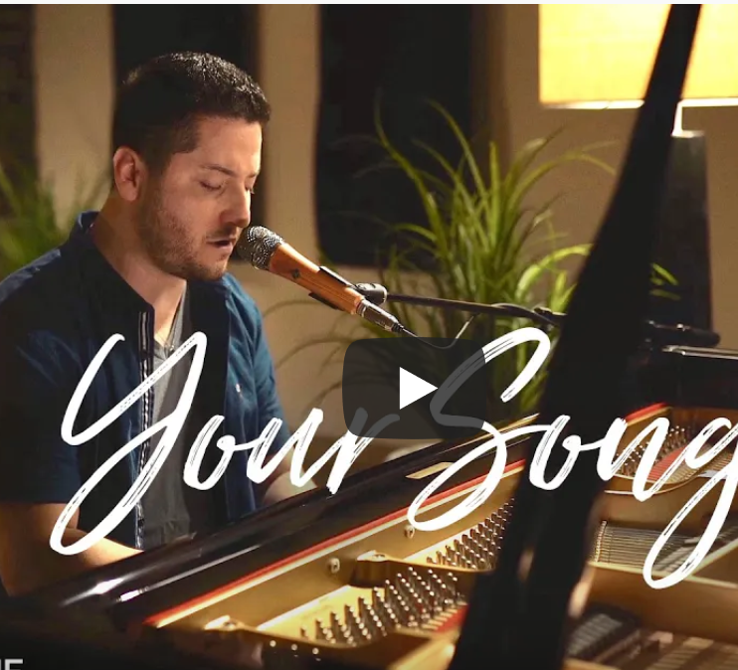
For your homework, find a song your class would enjoy and show how you could apply the concept of function to your song

Slide 8
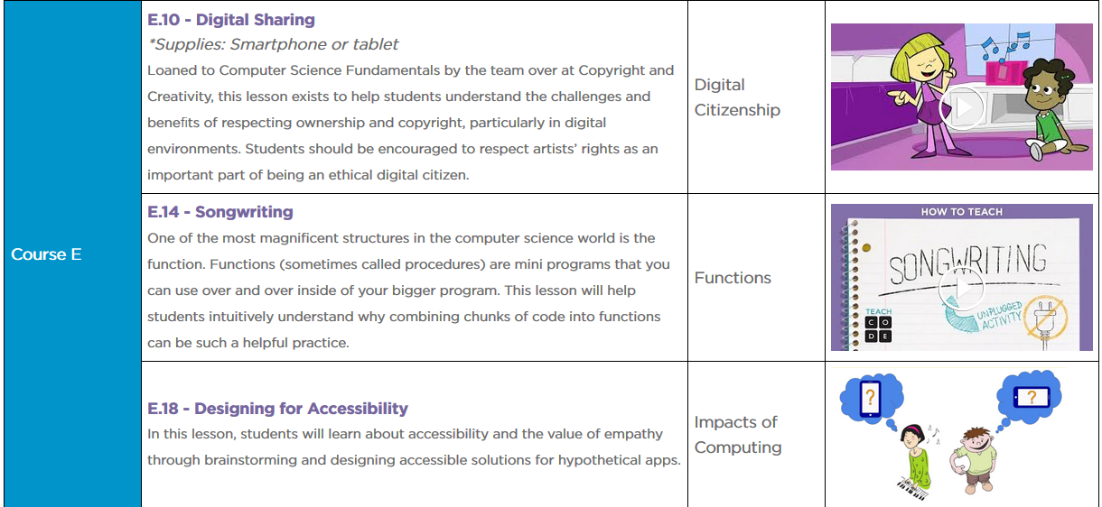
You can find a similar lesson at Cs Unplugged
Teacher examples at CS Makers PD: Uptown Funk, I wanna dance with somebody, Let it be, It’s a hard knock life, Meant to be, Little Einstein's theme song
https://code.org/curriculum/unplugged

Slide 9
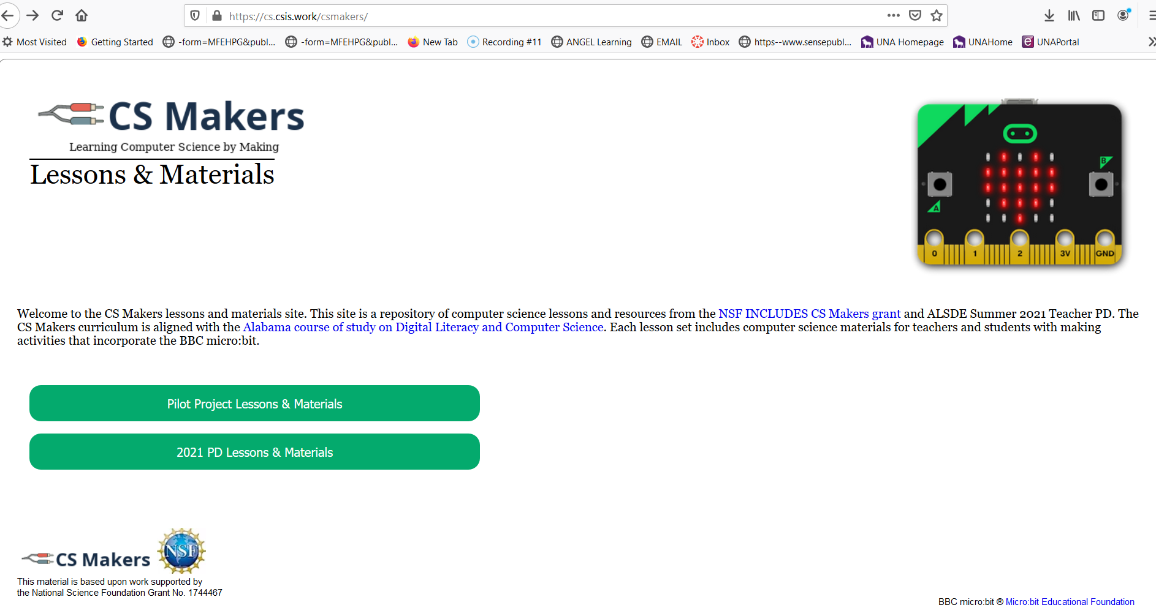
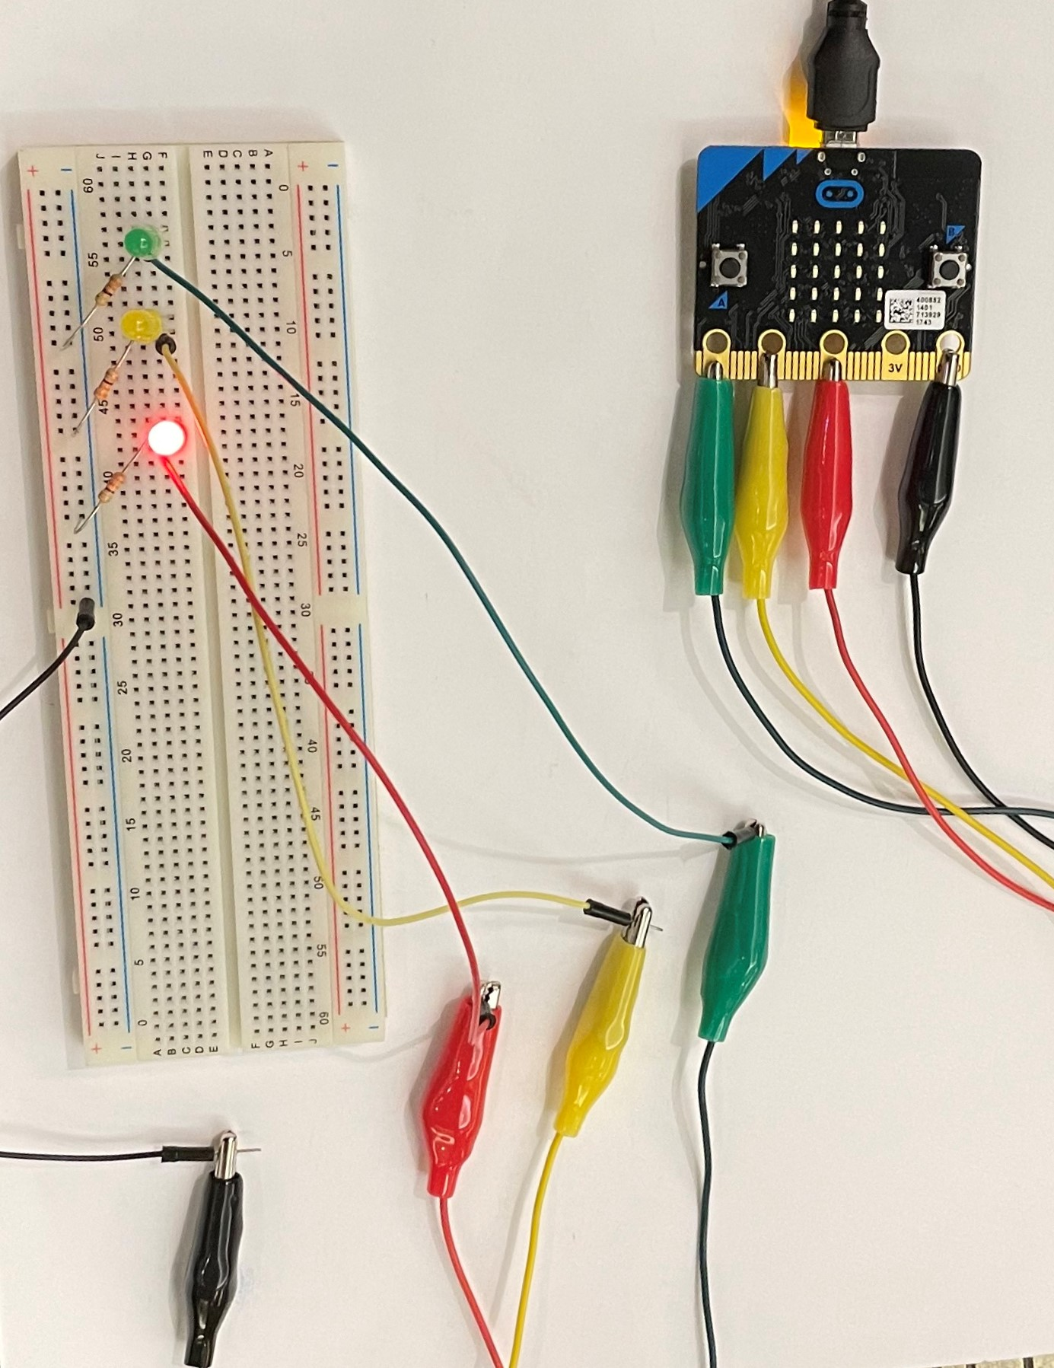
Traffic Light program is newly available on Your CS Makers web site http://cs.csis.work/csmakers/

Slide 10
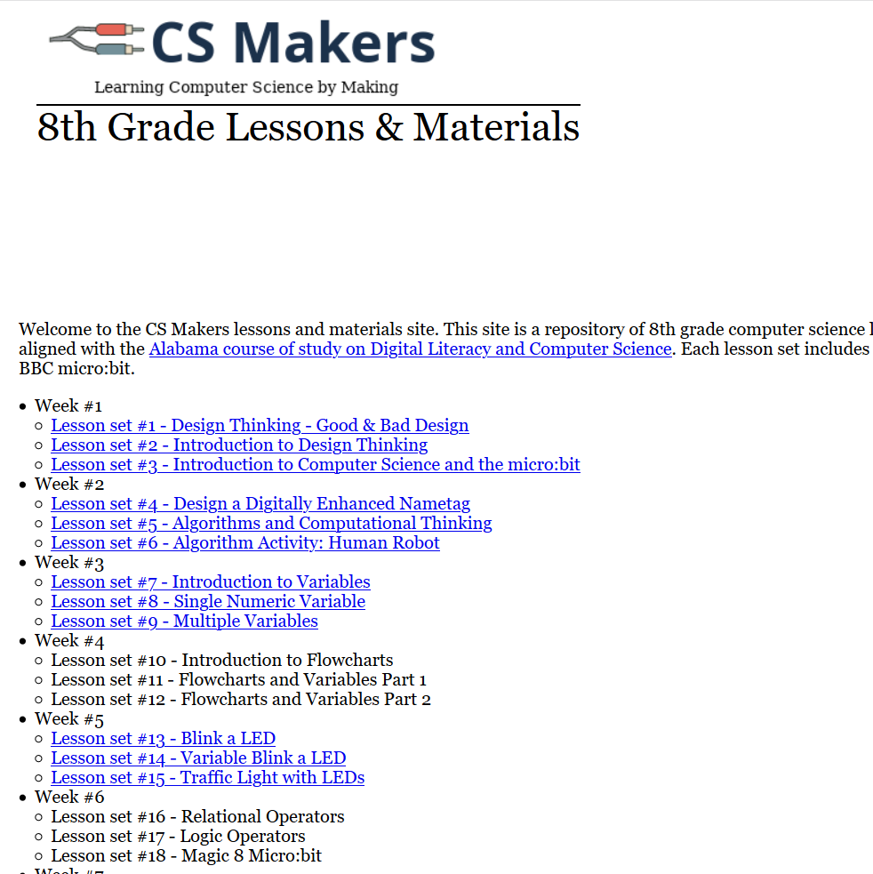
LESSON #15

Slide 11
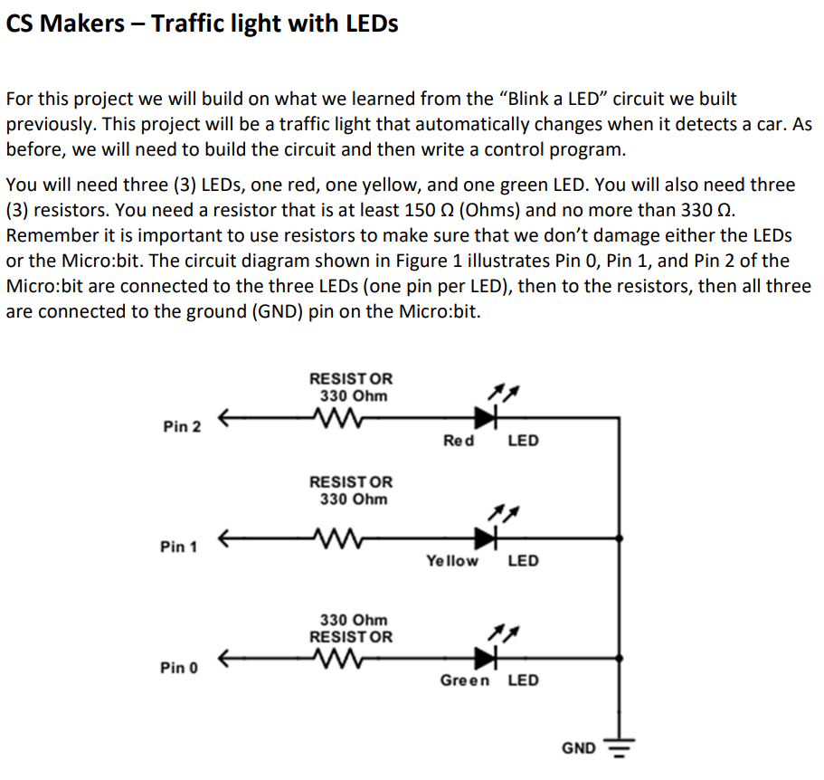
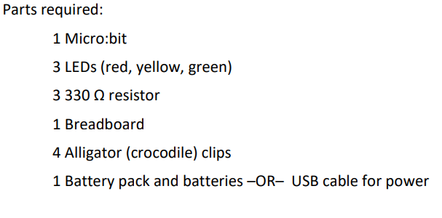
You might want to do this with your class first, then when you introduce functions, Pick it back up

Slide 12
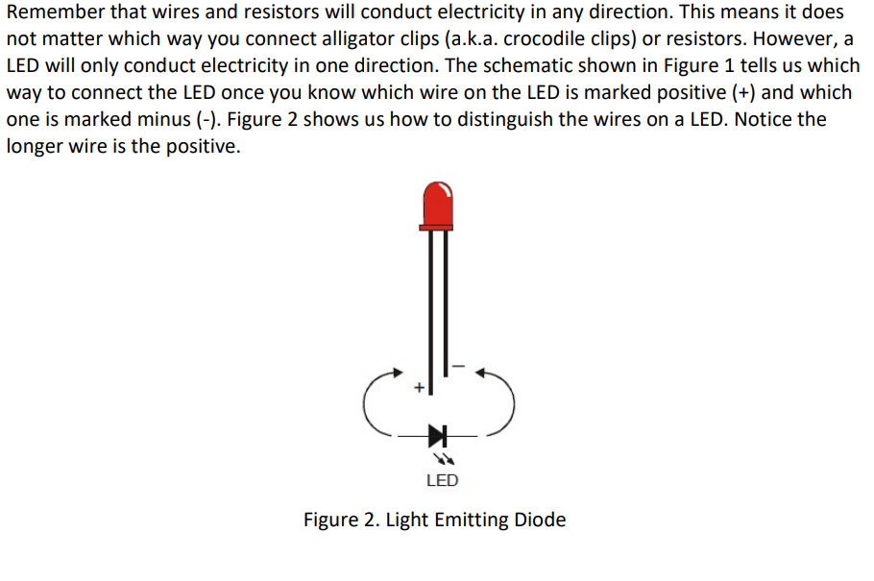
led info

Slide 13
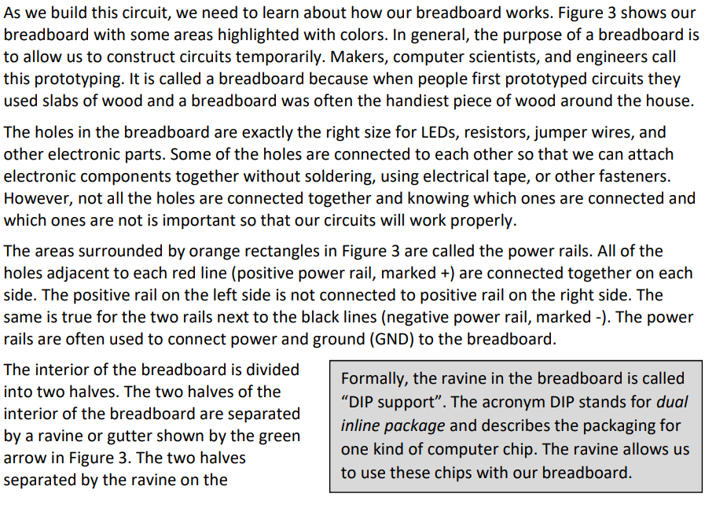
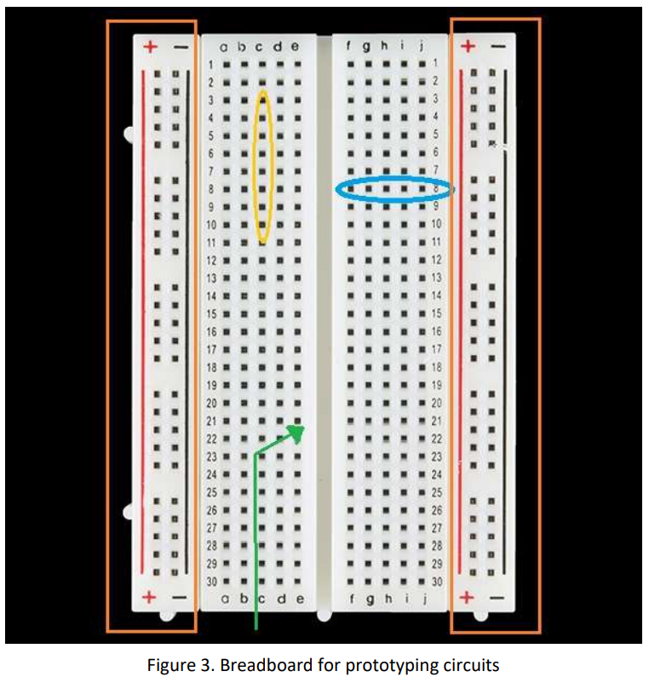
breadboard intro

Slide 14
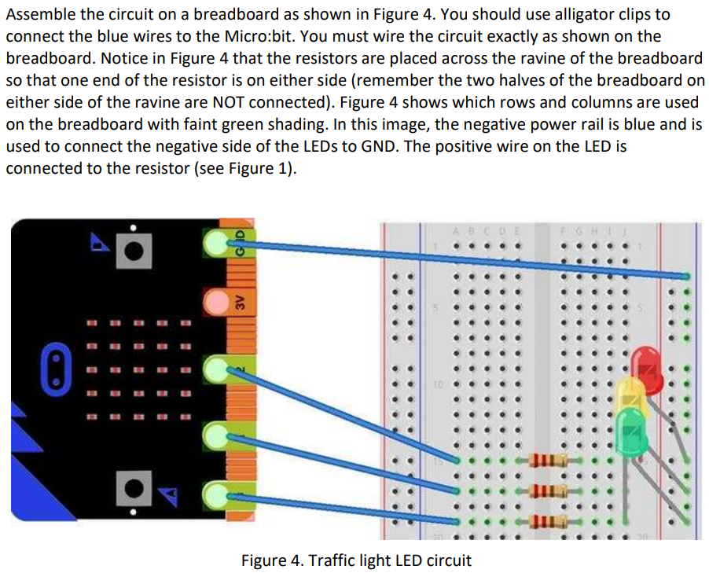
Build the circuit on the breadboard

Slide 15
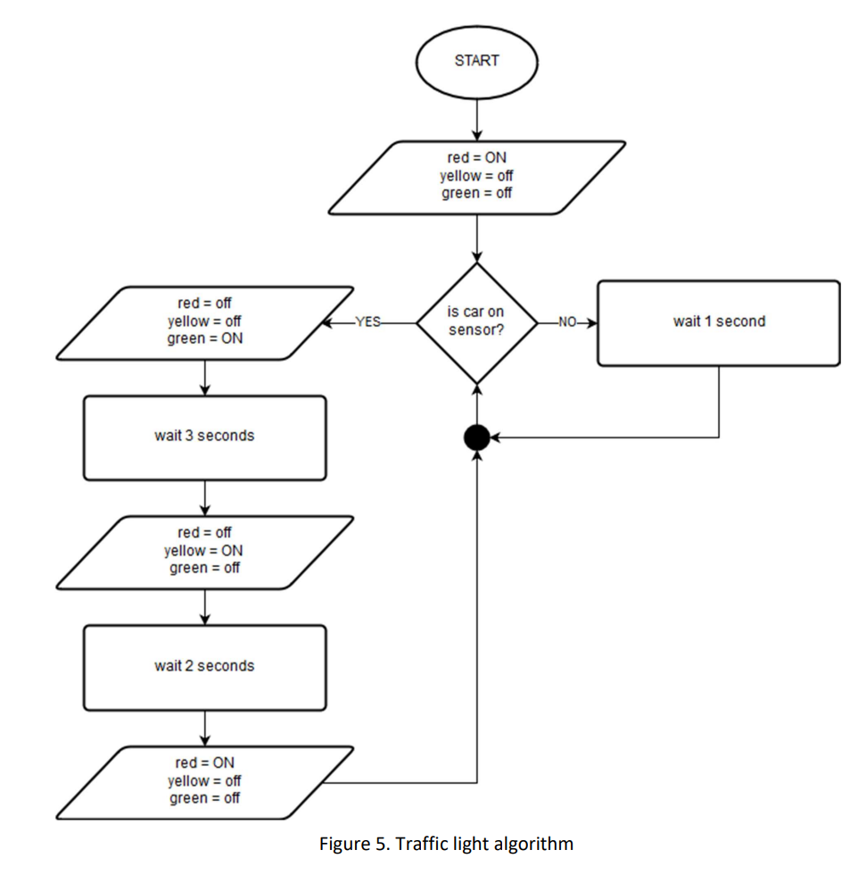
Review flowchart

Slide 16
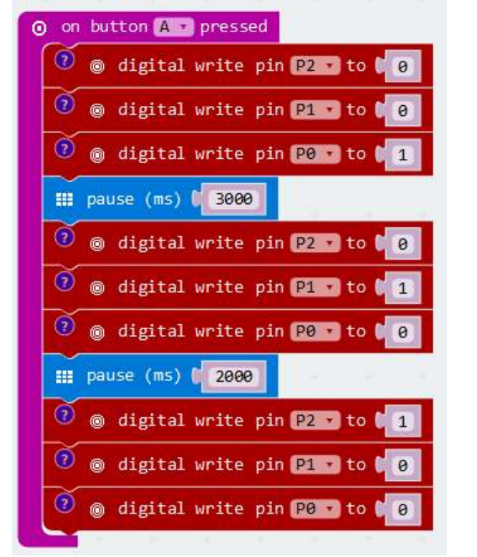
Traffic light program

Slide 17

Can we use functions to simplify this program?
Our traffic light is initialized as red and we are “waiting for a car to arrive.” We will use a pushbutton to indicate a car has been detected.
Once a car arrives, we will change the light to green and start a timer to change from green to yellow to red again.
Let’s use a FUNCTION to operate the lights.

Slide 18
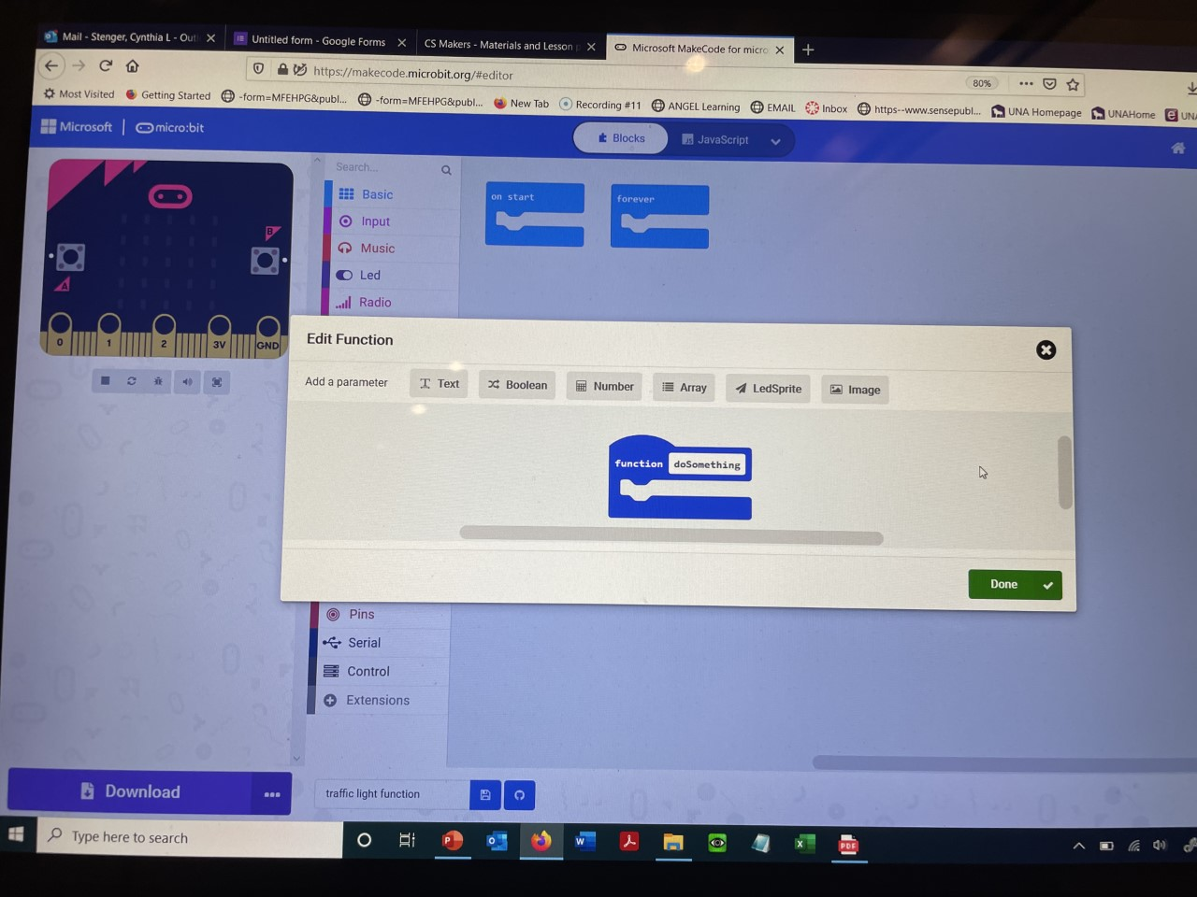

Slide 19
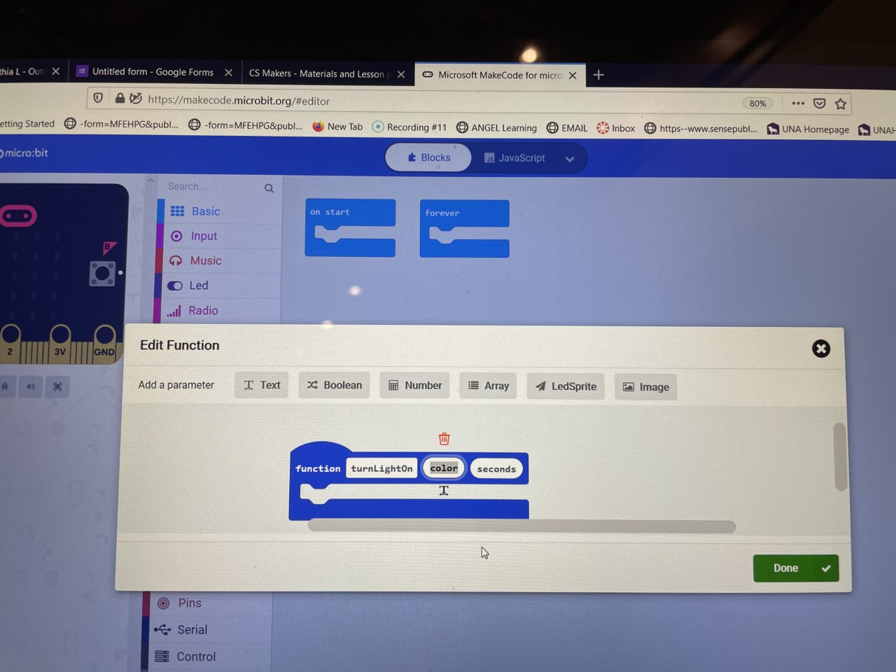

Slide 20
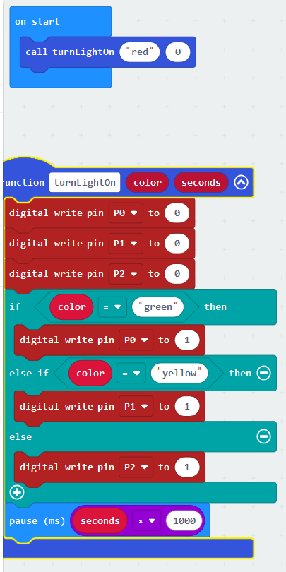
Call function

Slide 21
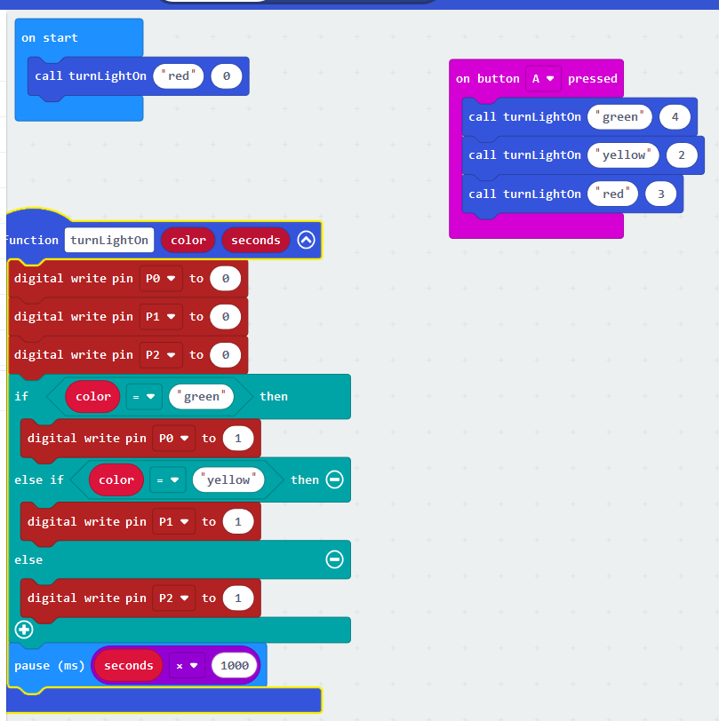

Slide 22
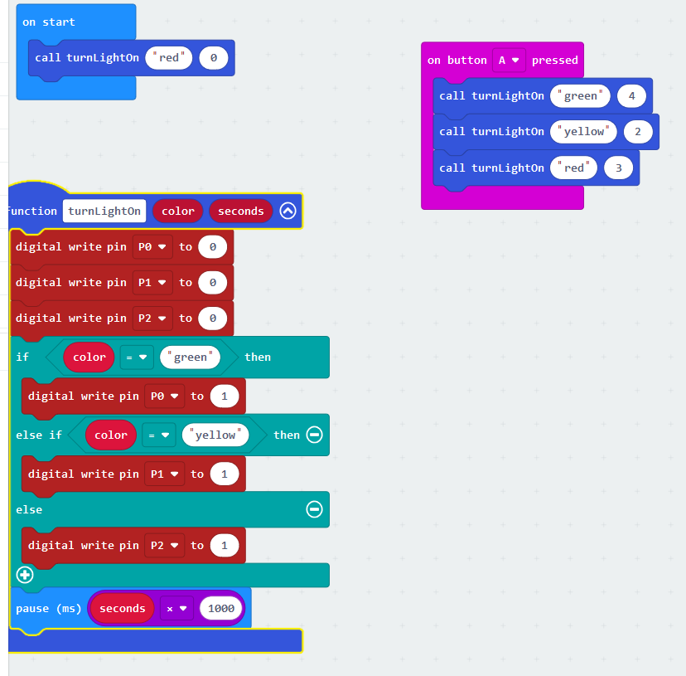
Traffic light using function

Slide 23
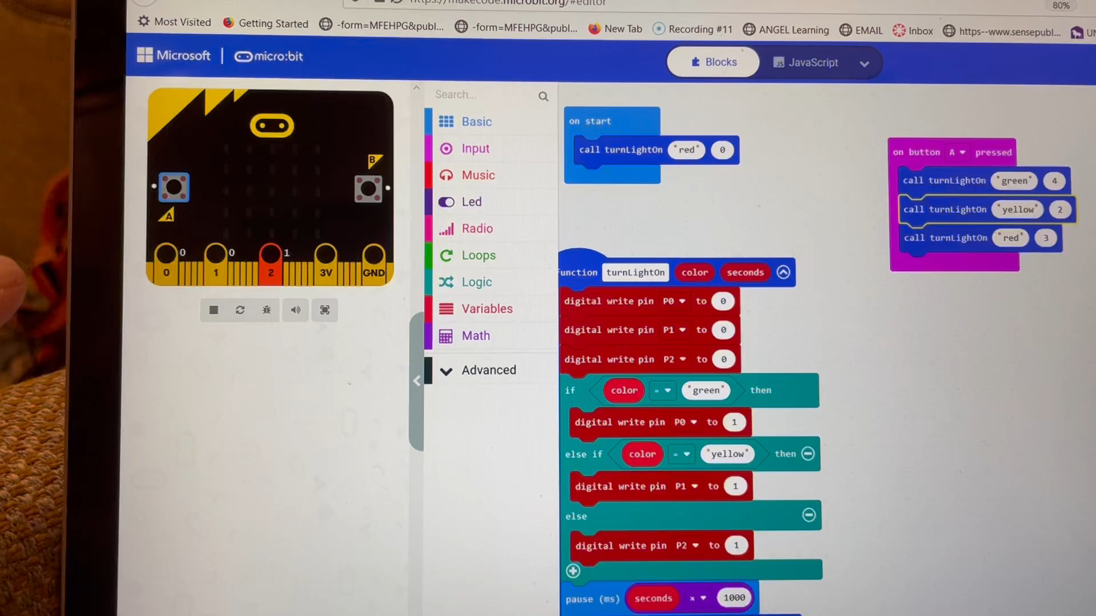
Check your program on the emulator

Slide 24
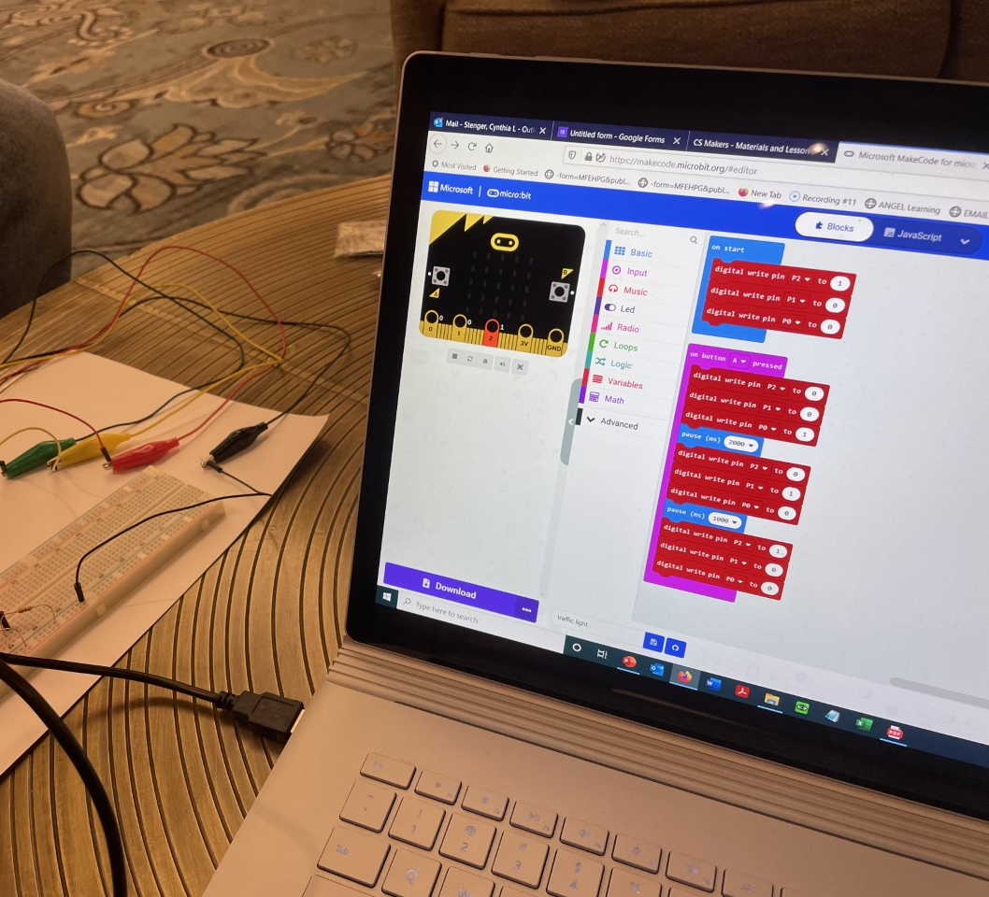
Download your program

Slide 25
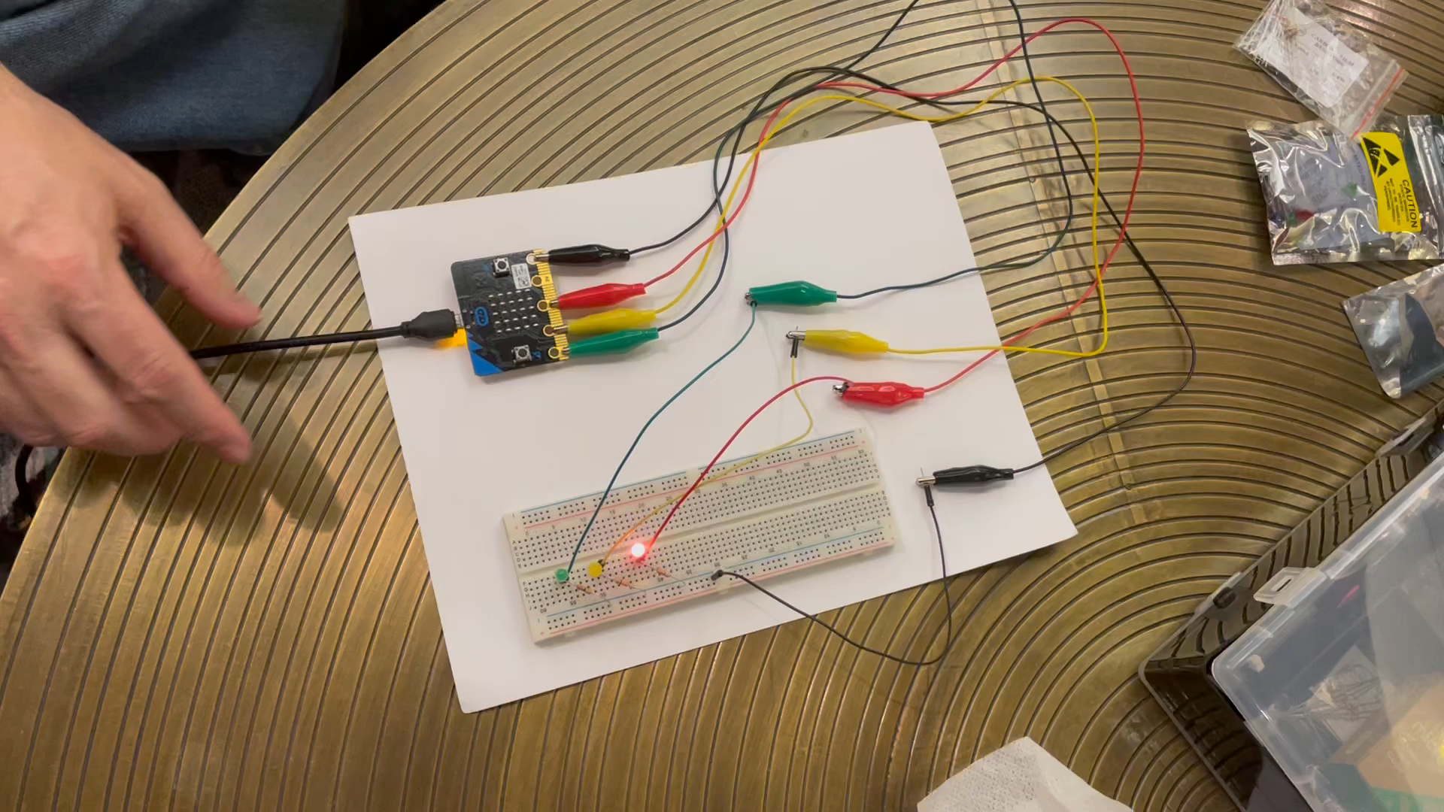
Video of traffic light

